Slide 1
Web Development Using
ASP .NET

Slide 2
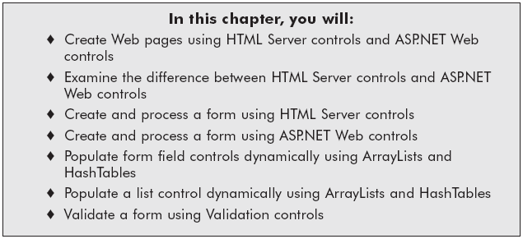
Chapter Objectives

Slide 3
Web Controls
A control is an object that can be drawn on to the Web Form to enable or enhance user interaction with the application.
When you create ASP.NET Web pages, you can use these types of controls:
  HTML server controls
  Web server controls
  Validation controls
  User controls

Slide 4
HTML server controls HTML elements exposed to the server so you can program them. HTML server controls expose an object model that maps very closely to the HTML elements that they render.
Web server controls Controls with more built-in features than HTML server controls. Web server controls include not only form controls such as buttons and text boxes, but also special-purpose controls such as a calendar, menus, and a tree view control. Web server controls are more abstract than HTML server controls in that their object model does not necessarily reflect HTML syntax.

Slide 5
Validation controls Controls that incorporate logic to enable you to what users enter for input controls such as the TextBox control. Validation controls enable you to check for a required field, to test against a specific value or pattern of characters, to verify that a value lies within a range, and so on.
User controls Controls that you create as ASP.NET Web pages. You can embed ASP.NET user controls in other ASP.NET Web pages, which is an easy way to create toolbars and other reusable elements. For more information

Slide 6
HTML server controls
HTML server controls are HTML elements (or elements in other supported markup, such as XHTML) containing attributes that make them programmable in server code. By default, HTML elements on an ASP.NET Web page are not available to the server. Instead, they are treated as opaque text and passed through to the browser. However, by converting HTML elements to HTML server controls, you expose them as elements you can program on the server.
The object model for HTML server controls maps closely to that of the corresponding elements. For example, HTML attributes are exposed in HTML server controls as properties.

Slide 7
HTML server controls
Any HTML element on a page can be converted to an HTML server control by adding the attribute runat="server". During parsing, the ASP.NET page framework creates instances of all elements containing the runat="server" attribute. If you want to reference the control as a member within your code, you should also assign an id attribute to the control.
The page framework provides predefined HTML server controls for the HTML elements most commonly used dynamically on a page: the form element, the input elements (text box, check box, Submit button), the select element, and so on. These predefined HTML server controls share the basic properties of the generic control, and in addition, each control typically provides its own set of properties and its own event.

Slide 8
Web server controls
Web server controls are a second set of controls designed with a different emphasis. They do not necessarily map one-to-one to HTML server controls. Instead, they are defined as abstract controls in which the actual markup rendered by the control can be quite different from the model that you program against. For example, a RadioButtonList Web server control might be rendered in a table or as inline text with other markup.
Web server controls include traditional form controls such as buttons and text boxes as well as complex controls such as tables. They also include controls that provide commonly used form functionality such as displaying data in a grid, choosing dates, displaying menus, and so on.
Web server controls offer all of the features described above for HTML server controls (except one-to-one mapping to elements) and these additional features:

Slide 9
Web server controls
A rich object model that provides type-safe programming capabilities.
Automatic browser detection. The controls can detect browser capabilities and render appropriate markup.
For some controls, the ability to define your own layout for the control using Templates.
For some controls, the ability to specify whether a control's event causes immediate posting to the server or is instead cached and raised when the page is submitted.
Support for themes, which enable you to define a consistent look for controls throughout your site.
Ability to pass events from a nested control (such as a button in a table) to the container control.

Slide 10
Label
The Label Web Server is used to label other parts of the application. They are used to display text which the user can't change. To display text on a label we use the text property.

Slide 11
Literal
A Literal Web Server control doesn't have any visual appearance on a Web Form but is used to insert literal text into a Web Form. This control makes it possible to add HTML Code directly in the code designer window without switching to design view and clicking the HTML button to edit the HTML.

Slide 12
Buttons
A Button Web Server control is a control which we click and release to perform some action.
Button Event
The default event of the Button is the Click event which looks like this in code:
Private Sub Button1_Click(ByVal sender As System.Object,_
ByVal e As System.EventArgs) Handles Button1.Click
'Implementation Omitted
End Sub

Slide 13
Link Button
The LinkButton Web server control is a hyperlink style button control. It looks like a hyperlink control but is actually a button control with click and command events.

Slide 14
ImageButton Control
The ImageButton Web server control is used to display images and responds to mouse clicks on the image.
To set the Image for this control we use the ImageUrl property. Image buttons support both Click and Command events. When we handle Click events, we are passed the actual location of the mouse in the image. We can use Command event handlers to make the image button work like a command button.

Slide 15
DropDownList
The DropDownList Web server control is same as the ListBox control but it supports only single selection and displays items in a drop-down manner

Slide 16
ListBox
The ListBox Web server control displays a list of items from which we can make a selection. We can select one or more items from the list of items displayed.

Slide 17
CheckBox
The CheckBox Web server control gives us an option to select, say, yes/no or true/false. A checkbox is clicked to select and clicked again to deselect some option. When a checkbox is selected, a check (a tick mark) appears indicating a selection.

Slide 18
CheckBoxList
The CheckBoxList Web server control displays a number of checkboxes at once.
This control provides a multi selection check box group that can be dynamically generated with data binding.
It contains an Items collection with members that correspond to individual items in the list.

Slide 19
RadioButtonList
The RadioButtonList Web server control is used to display a list of radio buttons.
This control provides us with a single-selection radio button group that can be dynamically generated via data binding.
The Items property of this control allows us to add items to the control.

Slide 20
RadioButton
The RadioButton Web server control is similar to CheckBox but RadioButtons are displayed as rounded instead of box.

Slide 21
Image
The Image Web server control is used to display an image on a Web page. To set the image to be displayed for this control we use the ImageUrl property.

